Slide 1
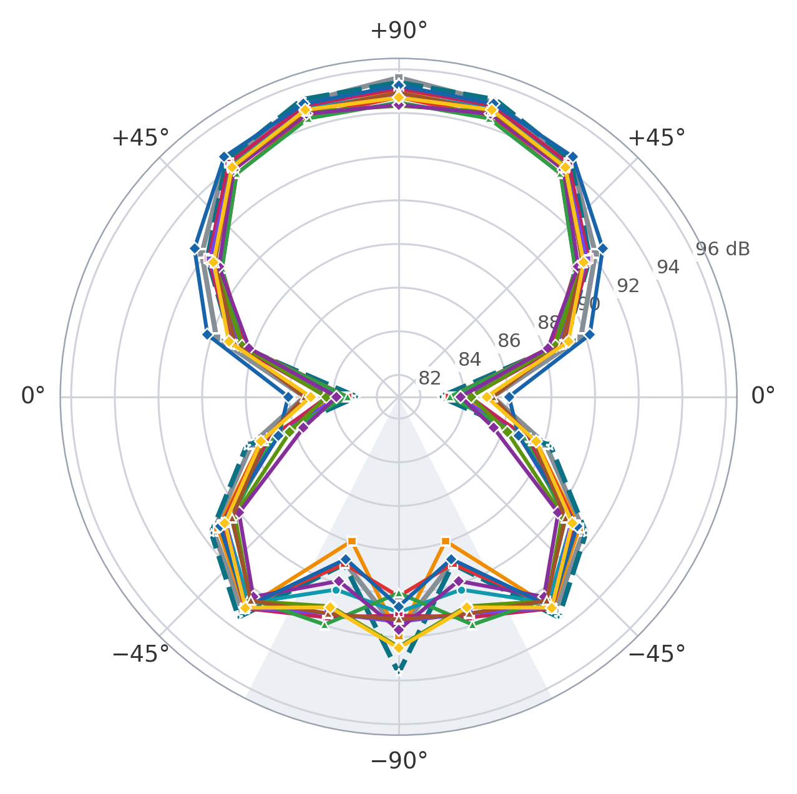
THE DUCT LININGS
Duct linings at 2000 µs
Mean level over the arc. Markers: ★ 3 Nov, ■ 2 Nov, ● 30 Oct, ◆ 29 Oct, ▲ 28 Oct. † lining fitted the old way (before 30 Oct). The bare prop is off the plot.
level
thrust
rpm
Bare prop, no duct
■ 2 Nov
80.0 dB
10.56 N
11,807
Felt, double + rubber †
◆ 29 Oct
90.5 dB
8.69 N
12,177
Thinsulate, 4 layers
■ 2 Nov
90.6 dB
9.22 N
12,157
Felt †
▲ 28 Oct
90.7 dB
8.96 N
12,112
Thinsulate, 2 layers
■ 2 Nov
90.9 dB
8.78 N
12,205
Felt, double layer †
◆ 29 Oct
90.9 dB
8.62 N
12,196
Thinsulate, 6 layers
● 30 Oct
91.0 dB
8.64 N
12,176
Thinsulate, 10 layers
■ 2 Nov
91.0 dB
8.89 N
12,177
PU foam †
▲ 28 Oct
91.1 dB
8.16 N
12,234
Thinsulate, 8 layers
■ 2 Nov
91.2 dB
8.82 N
12,200
Rubber †
◆ 29 Oct
91.3 dB
7.58 N
12,292
PU foam + rubber †
◆ 29 Oct
91.3 dB
8.33 N
12,217
Duct + inlet, no lining
★ 3 Nov
91.4 dB
10.12 N
12,078
Duct, no lining
■ 2 Nov
91.5 dB
7.99 N
12,269
+1.23 N
Thinsulate, 4 layers against the unlined duct, both 2 Nov: it wins back 48 % of the 2.57 N the empty duct loses to the bare prop, and is 0.9 dB quieter from −54° to +90°.
Every duct is louder than the bare prop: 90.5–91.5 dB against 80.0 dB, at 10.56 N and 11,807 rpm bare. Set-ups marked † are from other days and the old fit: indicative only.
Inlet (dashed, 3 Nov): 10.12 N, +2.13 N over the unlined duct and 0.44 N short of the bare prop, at the same level (−0.3 dB from −54° to +90°; −2.4 dB on the axis). A repeat agreed to 0.04 N; the comparison crosses days.
28 Oct–3 Nov 2026, APC 8x4.5MR, AXI 2217/12, 500 Hz–24 kHz, 2000 µs, mean of 3 repeats, corrected files. Axis 81–96.5 dB. Grey: −90°/−72°, probably in the flow. rpm = stand × 60/7.
1
Notes:
All set-ups are the 8-inch APC 8x4.5MR on the AXI 2217/12 in the r27 duct. The bare prop, the unlined duct and Thinsulate 2/4/8/10 are from 2 Nov; the duct with the inlet (no lining) from 3 Nov, run 1, whose repeat (base r27-duct-unlined-inlet-trial-2026-11-03) gave 10.08 N and 0.0-0.2 dB from -54 to +90 degrees; Thinsulate 6 from 30 Oct; felt and PU foam from 28 Oct; felt double, felt double + rubber, rubber and PU foam + rubber from 29 Oct. The linings from 28-29 Oct were fitted the old way: with the new fit (from 30 Oct) the Thinsulates gave 8-26 % more thrust than their old-fit runs, so the old-fit values are probably low and are not comparable with the rest. The PU foam base also holds a 27 Oct run that was deleted on the Pi; only the 28 Oct run is used. Only the 2 Nov set-ups are compared with each other (the headline numbers). Each base: the PWM 2000 step of 3 repeats; level per microphone is the total level 500 Hz to 24 kHz in dB SPL with the corrected microphone files, mean over the 3 repeats, and the list gives the mean over the eleven positions. Thrust (the stand reads negative, shown as magnitude), rpm and current are the median of the second half of each step, mean over the 3 repeats; rpm is the stand reading (electrical) times 60/7 for the 14-pole motor. Duct and propeller are one piece on the stand, so the thrust includes the duct.
The radial axis is zoomed to the ducted set-ups, so the bare prop (74-80 dB at most positions, 96.1 dB at -90 degrees) is not drawn. The -90 and -72 degree positions vary run to run by about 1 dB even without a remount and probably sit in the flow, so their levels are less trustworthy than the rest of the arc.
Bare prop, no duct (2 Nov, base axi2217__8in__none__r27-8x45mr-bare-prop): 80.0 dB (repeat-to-repeat spread of the mean 0.69 dB), thrust 10.56 N (repeats 10.51–10.64), 11,807 rpm (11777–11824), 22.95 A; per microphone from +90 to -90: 74.4, 74.3, 77.9, 80.2, 80.6, 80.7, 77.2, 79.2, 80.3, 79.4, 96.1 dB.
Duct, no lining (2 Nov, base axi2217__8in__duct-unlined__r27-duct-unlined): 91.5 dB (repeat-to-repeat spread of the mean 0.47 dB), thrust 7.99 N (repeats 7.95–8.02), 12,269 rpm (12245–12291), 20.96 A; per microphone from +90 to -90: 85.3, 89.8, 92.1, 94.5, 95.2, 95.6, 88.1, 91.5, 93.2, 89, 91.7 dB.
Duct + inlet, no lining (3 Nov, base axi2217__8in__duct-unlined-inlet__r27-duct-unlined-inlet): 91.4 dB (repeat-to-repeat spread of the mean 0.32 dB), thrust 10.12 N (repeats 10.11–10.15), 12,078 rpm (12058–12104), 21.69 A; per microphone from +90 to -90: 82.9, 89.1, 91.8, 94.4, 95.3, 95.4, 88.3, 91.6, 93.5, 89.1, 93.6 dB.
Thinsulate, 2 layers (2 Nov, base axi2217__8in__thinsulate-2-layers__r27-thinsulate-2-layers-trial-2026-11-02): 90.9 dB (repeat-to-repeat spread of the mean 0.22 dB), thrust 8.78 N (repeats 8.75–8.83), 12,205 rpm (12166–12230), 21.25 A; per microphone from +90 to -90: 83.9, 89, 91.6, 94, 94.7, 95, 87.6, 91.2, 93, 87.9, 92 dB.
Thinsulate, 4 layers (2 Nov, base axi2217__8in__thinsulate-4-layers__r27-thinsulate-4-layers): 90.6 dB (repeat-to-repeat spread of the mean 0.12 dB), thrust 9.22 N (repeats 9.13–9.28), 12,157 rpm (12141–12171), 21.45 A; per microphone from +90 to -90: 83.3, 88.4, 91, 93.6, 94.5, 94.7, 87.6, 91, 92.9, 89, 90.1 dB.
Thinsulate, 6 layers (30 Oct, base axi2217__8in__thinsulate-6-layers__r27-thinsulate-6-layers): 91.0 dB (repeat-to-repeat spread of the mean 0.16 dB), thrust 8.64 N (repeats 8.55–8.73), 12,176 rpm (12123–12228), 21.11 A; per microphone from +90 to -90: 84.2, 89.1, 91.7, 94.1, 94.9, 94.9, 87.2, 90.8, 92.7, 90.3, 90.9 dB.
Thinsulate, 8 layers (2 Nov, base axi2217__8in__thinsulate-8-layers__r27-thinsulate-8-layers-archive-2026-11-02-trial-1619): 91.2 dB (repeat-to-repeat spread of the mean 0.11 dB), thrust 8.82 N (repeats 8.73–8.89), 12,200 rpm (12194–12208), 21.30 A; per microphone from +90 to -90: 84.3, 89.1, 91.8, 94.2, 95, 95.1, 87.2, 91, 93, 91.6, 91 dB.
Thinsulate, 10 layers (2 Nov, base axi2217__8in__thinsulate-10-layers__r27-thinsulate-10-layers): 91.0 dB (repeat-to-repeat spread of the mean 0.1 dB), thrust 8.89 N (repeats 8.88–8.92), 12,177 rpm (12152–12207), 21.40 A; per microphone from +90 to -90: 83.7, 88.7, 91.7, 94, 94.7, 94.9, 86.8, 90.8, 92.9, 91.4, 91.3 dB.
Felt (28 Oct, old fit, base axi2217__8in__felt__r27-felt): 90.7 dB (repeat-to-repeat spread of the mean 0.3 dB), thrust 8.96 N (repeats 8.94–8.98), 12,112 rpm (12096–12143), 21.44 A; per microphone from +90 to -90: 83.3, 88.5, 91, 93.6, 94.4, 94.5, 87, 90.5, 92.5, 92, 90 dB.
Felt, double layer (29 Oct, old fit, base axi2217__8in__felt-2-layers__r27-felt-2-layers): 90.9 dB (repeat-to-repeat spread of the mean 0.05 dB), thrust 8.62 N (repeats 8.54–8.72), 12,196 rpm (12168–12219), 21.14 A; per microphone from +90 to -90: 84.3, 88.5, 91.4, 94, 94.7, 94.3, 86.2, 90.3, 92.6, 91.1, 92.5 dB.
Felt, double + rubber (29 Oct, old fit, base axi2217__8in__felt-2-layers-rubber__r27-felt-2-layers-rubber): 90.5 dB (repeat-to-repeat spread of the mean 0.29 dB), thrust 8.69 N (repeats 8.6–8.76), 12,177 rpm (12165–12197), 21.18 A; per microphone from +90 to -90: 83.8, 88.2, 91.2, 93.9, 94.6, 94.4, 85.6, 90, 92.3, 89.9, 91.7 dB.
Rubber (29 Oct, old fit, base axi2217__8in__rubber__r27-rubber): 91.3 dB (repeat-to-repeat spread of the mean 0.21 dB), thrust 7.58 N (repeats 7.52–7.67), 12,292 rpm (12276–12304), 20.67 A; per microphone from +90 to -90: 86.1, 90.2, 92.6, 94.6, 95.1, 95.3, 86.8, 91.1, 92.9, 88.8, 90.6 dB.
PU foam (28 Oct, old fit, base axi2217__8in__pu-foam__r27-pu-foam): 91.1 dB (repeat-to-repeat spread of the mean 0.11 dB), thrust 8.16 N (repeats 8.09–8.24), 12,234 rpm (12176–12267), 20.90 A; per microphone from +90 to -90: 85.3, 88.9, 91.4, 94, 94.8, 94.9, 87.5, 90.4, 92.5, 91.4, 91.2 dB.
PU foam + rubber (29 Oct, old fit, base axi2217__8in__pu-foam-rubber__r27-pu-foam-rubber): 91.3 dB (repeat-to-repeat spread of the mean 0.1 dB), thrust 8.33 N (repeats 8.28–8.37), 12,217 rpm (12203–12242), 21.01 A; per microphone from +90 to -90: 85, 89.2, 91.5, 94, 94.8, 94.7, 87.6, 90.8, 92.9, 91.1, 92.5 dB.

